Slide 1
ICEB 2019 in Newcastle Upon Tyne
by
Dr. Honglei Li
Department of Computer & Information Sciences
Northumbria University
Newcastle Upon Tyne
United Kingdom
Honglei.Li@Northumbria.ac.uk

Slide 2
Agenda
Introduction to Northumbria University
Local Information
Conference CFP
Conference Date
Conference Theme and Tracks
Milestones of Required Activities
Meeting Venue
Hotel Location and Pricing
Conference Schedule
ICEB 2019 Conference Events Arrangement
Registration Fee Structure
Visa information
Airport Transportation Information
Optional Tours
Local Cultural Attractions
Local support Facilities
Conference Team Structure
Conference Committees
Why Our Team Should be Authorized?

Slide 3
Introduction to Northumbria University
Research-rich, business-focused, professional university with a global reputation for academic excellence
its origins in the Rutherford College, founded in 1880
Voted the best place in the UK for students
Top 50 for research power

Slide 4
Local Information
Newcastle Upon Tyne (River Tyne)
the largest city in North-East England
annually hosts the world's largest half marathon, the Great North Run

Slide 5
Conference CFP
The 19th International Conference on Electronic Business
The International Conference on Electronic Business is an affiliated conference of Association of Information Systems. It brings together leading Electronic Business scholars in Asia and around the world. The conference is held under the supervision of The International Consortium for Electronic Business (ICEB) editorial board and is the top academic Electronic Business conference in the world. It brings together top researchers in Electronic Business field and related areas within Asia and around the world to present cutting-edge research and exchange intellectual ideas.
The 18th International Conference on Electronic Business will be hosted by the Department of Computer and Information Sciences at Northumbria University in Newcastle Upon Tyne, United Kingdom, and co-sponsored by The International Consortium for Electronic Business and International Journal of Electronic Business.
The Conference will be held in Newcastle Upon Tyne, United Kingdom on December 8-12, 2019. The theme of this year’s conference is Artificial Intelligence Empowered Business Processes under Smart City Environment. Information and communication technology (ICT) has profound impact on re-designing our environment with all the new technologies, by transforming the connections among people, organizations, governments and communities. With the IoT as the infrastructure and recent breakthroughs in AI algorithms. We are shifting toward the smart city age with many major business processes are empowered, changed, or replaced by AI technology. Governments and organizations around the world are seeking new ways to improve efficiency of services and quality of life. Artificial Intelligence Empowered Business Processes under smart city environment as a vision responds to such a request. In this conference, we hope to bring international scholars to explore the meaning, applications, practices, and issues related to Artificial Intelligence Empowered Business Processes under Smart City Environment.

Slide 6
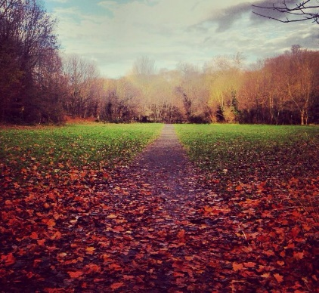
Conference date
Traditional Date
8-12 December 2019
Right before ICIS 2019 in Munich, Germany
Can be held in Hilton
Flexible Date
20-24 October 2019
Beautiful autumn scenery
Can be held in Hilton (not assured)
The backup conference venue is the university campus

Slide 7
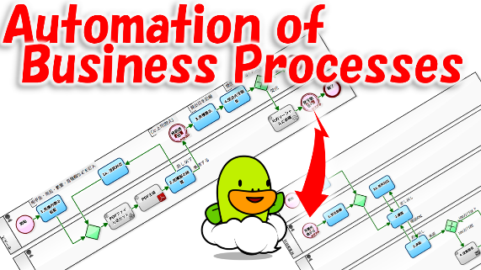
Conference Theme and Tracks
Artificial Intelligence Empowered Business Processes
Track 1. Smart city
Track 2. Big data analytics and business intelligence
Track 3. Blockchain and smart technologies
Track 4. Artificial intelligence and its applications
Track 5. Cultural and social issues related to electronic business
Track 6. Digital marketing and consumer behavior
Track 7. Digital transformations in enterprises
Track 8. E-entrepreneurship
Track 9. E-governance, policy and law
Track 10. E-healthcare
Track 11. Knowledge management and sharing
Track 12. New technology acceptance, adoption and diffusion
Track 13. Security, trust, and privacy issues
Track 14. Internet of Things
Track 15. Smart homes
Track 16. Smart manufacturing
Track 17. Smart tourism and hospitality
Track 18. Social media and social computing
Track 19. Strategies and models of electronic business
Track 20. Supply chain management and e-logistics
Track 21. Virtual communities and social commerce
Track 22. Web mining and recommendation systems

Slide 8
Milestones of required activities
Dates | Activities
December 31 2018 | CFP Final Version Finalized
January 31 2019 | Programe Website Launched
February 15 2019 | Committee on Board
March 31 2019 | First Round of Promotion of CFP, Website Finalized
March 15 2019 | Confirmation of Keynote Speakers
April 30 2019 | Submission Portal Open
May 31 2019 | 2nd Round of Promotion of CFP
August 31 2019 | Deadline for submitting papers or abstracts
September 30 2019 | Notification of acceptance for conference presentation
October 31 2019 | Presenter's paper registration and last day of early-bird registration
November 5 2019 | Program schedule announcement
November 15 2019 | Camera-ready preliminary paper submissions and last day of regular registration without US$50 late fee
December 7 2019 | Web-posting of preliminary conference proceedings
December 8-12 2019 | Conference events
December 15 2019 | Submission of camera-ready revised papers for formal conference proceedings
December 31 2019 | Publication of formal Conference Proceedings

Slide 9
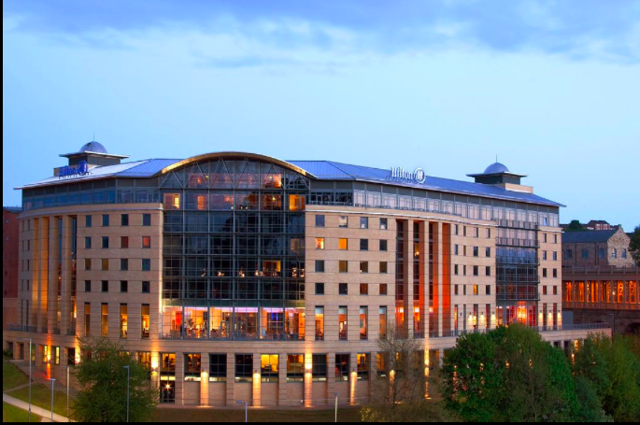
Meeting venue
Hilton Newcastle
Host up to 300 people
Backup Venue:
Northumbria University Business School up to 200 delegates

Slide 10
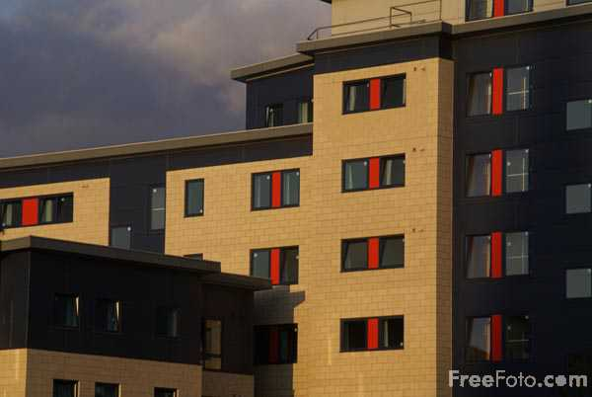
Hotel location and pricing
Hilton Hotel
Room price
Single room: $140 per night/£105 per night
Double room: $150 per night/£115 per night
Local Accommodations
Around £60 per night for single room
Can consider university accommodation

Slide 11
Conference schedule
Day | Weekday | Events
08/12 | SUN | Registration and invited board meeting (Welcome reception with hot buffet)
09/12 | MON | Opening keynotes and special sessions for industry panels, workshops, and editor panel. It includes morning and afternoon coffee breaks, the LUNCH event, and the FORMAL WELCOME DINNER.
10/12 | TUE | Paper sessions with morning and afternoon coffee breaks and the LUNCH event. It include the FORMAL CONFERENCE DINNER with the Annual General Meeting (AGM)
11/12 | WED | Paper sessions with morning and afternoon coffee break and LUNCH event, Dinner on your own and a self-funded river escapes night tour is recommended.
12/12 | THU | Optional self-funded industry site visits

Slide 12
Registration Fee Structure
 |  | Paid On or Before Oct. 31 (Early-bird price) | Paid After Oct. 31 (Regular price) | Paid After Nov. 15 (With US$50 late fee)
1 | Member Registration Fee | USD500 each person | USD550 each person | USD600 each person
2 | Member Registration Fee (Student) | USD250 each person | USD300 each person | USD350 each person
3 | Non-member Registration Fee | USD715 each person | USD786 each person | USD836 each person
4 | Non-member Registration Fee (Student) | USD358 each person | USD429 each person | USD479 each person
5 | Additional Paper Charge | USD350 for each additional title of full paper, WIP paper, or abstract

Slide 13
Visa Information
If you require a UK VISA to attend the conference, Please fill in the application form after completing your registration with payment. The conference organizer can send you an invitation letter that you may use for your VISA purposes. The letter will be emailed to you. Should you require a hard copy through post, please be aware that it may take up to two weeks to reach you and £15.00 is charged to cover the cost.

Slide 14
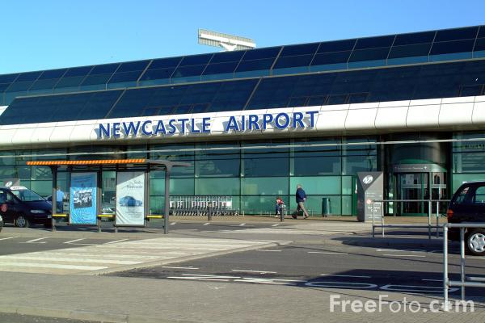
Airport transportation information
Newcastle International Airport is 8 miles away from the city centre
15 mintues by taxi (£10)
Newcastle has convenient metro from to the city centre
Alternative airport
DurhamTees Valley Airport (50 minutes by taxi)
Taxi
· Plan your visit, Web: http://www.traveline.info/ · ABC Taxis, Tel: 0191 232 3636, Web: http://www.abctaxisnewcastle.co.uk/ · Blueline Taxis, Tel: 0191 262 6666, Web: http://www.bluelinetaxis.com/
This Photo by Unknown Author is licensed under CC BY-NC-ND

Slide 15
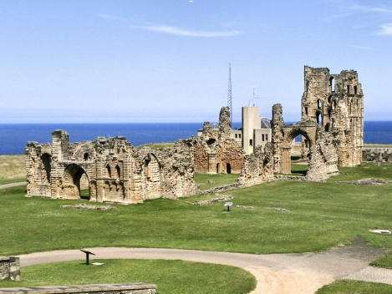
Optional Tour
Half Day
Whitley Bay
Tynemouth
£20 per person
Full Day
Holy Island
Lake District
£50 pounds per person

Slide 16
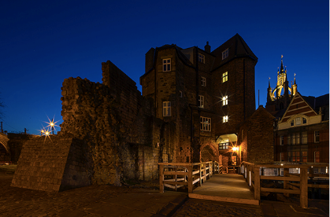
Local cultural attractions
BALTIC Centre for Contemporary Art
Newcastle Castle Keep
Angel of the North
St James' Park
Millennium Bridge
Beamish Museum

Slide 17
Local Support Facilities
North East Conference Event Support Team
University Conference and Event Support Team
PHD students
Northumbria University
Durham University
Newcastle University
This Photo by Unknown Author is licensed under CC BY-NC-ND

Slide 18
Conference Team Structure
Local Chair
Workshop Chair
Poster Chair
Sponsorship Chair
Website Chair
Technical Support Chair
Supporting Organization Chair

Slide 19
Conference Committees
Advisors: International Consortium for Electronic Business, USA International Journal of Electronic Business Organizer: Department of Computer & Information Sciences, Faculty of Engineering and Environment, University of Northumbria at Newcastle, Newcastle upon Tyne, United Kingdom

Slide 20
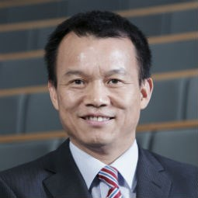
Conference Chair: Dr. Honglei Li, Senior Lecturer, Department of Computer & Information Sciences, Faculty of Engineering and Environment, University of Northumbria at Newcastle, Newcastle upon Tyne, United Kingdom Program Co-Chairs: Professor Savvas Papagiannidis, Professor, Newcastle University, Newcastle Upon Tyne, United Kingdom Dr. Zhibin Lin, Associate Professor, Durham University, Durham, United Kingdom Local Arrangement Co-Chair: Dr. Shan Shan, Northumbria University, Newcastle upon Tyne, United Kingdom
Dr. Honglei Li
Professor Savvas Papagiannidis
Dr. Zhibin Lin

Slide 21
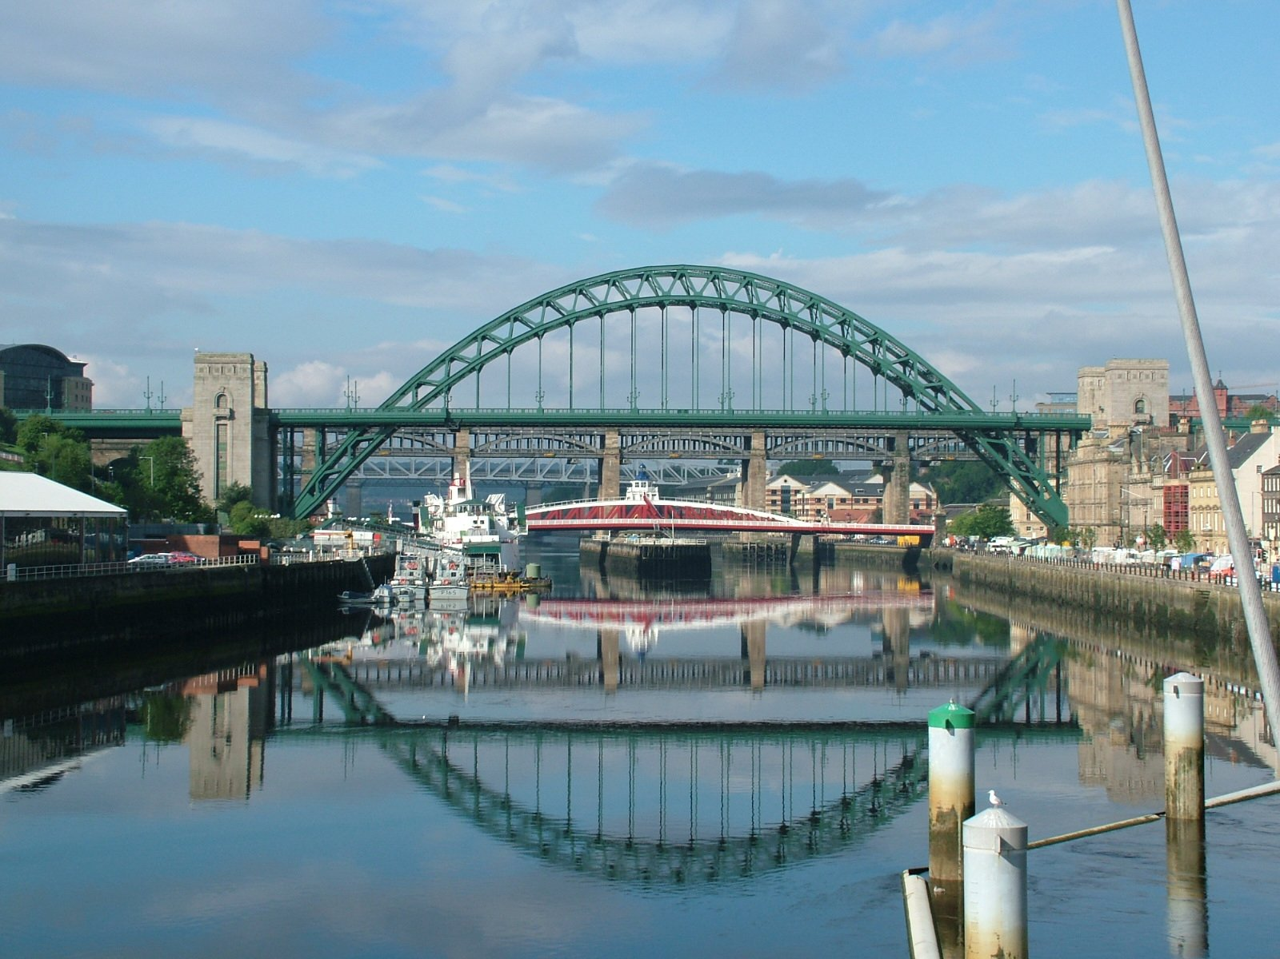
Welcome to Newcastle
Why Our Team Should be Authorized?
This Photo by Unknown Author is licensed under CC BY-SA

